Slide 1
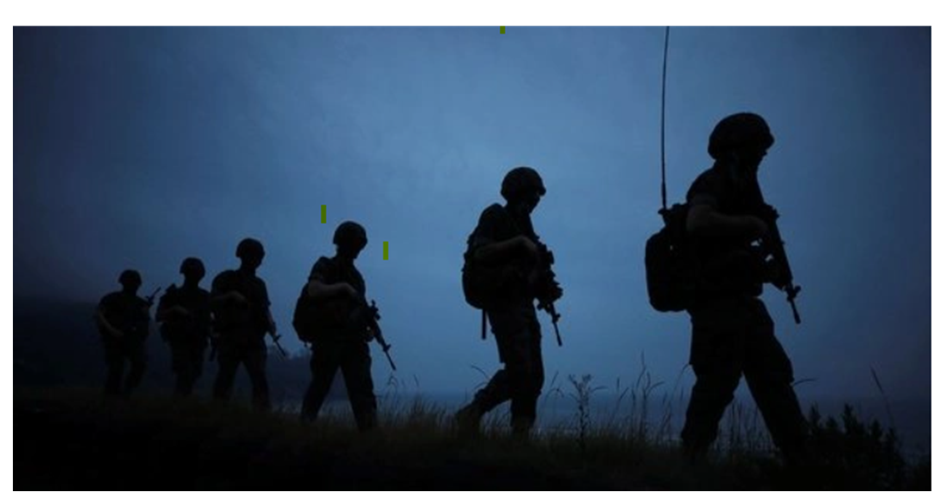

Notes:
John

Slide 2


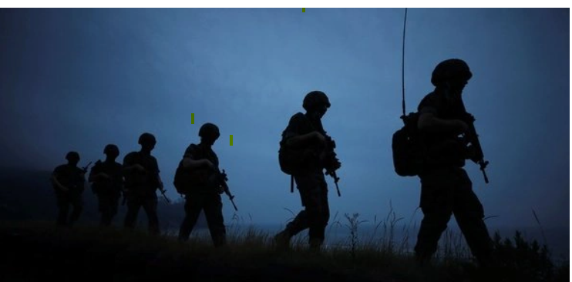
Market Volatility During International Conflicts
Reason topic was selected
With the current situation of Russia’s military invading Ukraine, the team has agreed to analyze the volatility of the stock market during war and uncertainty during international conflicts.
Group 1
Notes:
John

Slide 3
Market Volatility During International Conflicts
Definitions of Armed Conflict , Stock Market and Volatility
“State based Armed Conflict” – as defined by Uppsala Conflict Data Program (UCDP) is a “contested incompatibility that concerns government and/or territory where the use of armed force between two parties, of which one at least is a government of state, results in at least 25 battle related deaths in a calendar year”.
Stock Market - revolves around the trading of stocks, which are shares of ownership.
Volatility - rate at which the price fluctuates.
Group 1
Notes:
Theresa -

Slide 4
Market Volatility During International Conflicts
Description of the data exploration phase of the project
The Team first searched Kaggle to find stock market data for the 3 markets Dow Jones, Nasdaq, and S&P 500.
Next we searched for conflicts and found the UCDP– Department of Peace and Conflict Research website. This is a great website with multiple datasets of conflict data.
Group 1
Notes:
Theresa

Slide 5
Market Volatility During International Conflicts
Description of the source of data:
Stock Market data utilized from Kaggle: https://www.kaggle.com/rishidamarla/stock-prices-over-a-30-year-period
International conflict database from Uppsala Conflict Data Program - Department of Peace and Conflict Research:
https://ucdp.uu.se/downloads/ucdpprio/ucdp-prio-acd-211.pdf
Cleaned Dataset files used for this project:
DowJones.csv
SP500.csv
Nasdaq.csv
joined_stocks.csv
cleaned_conflict_1.csv
geo_conflict_data.csv
new_geo_conflict_updated.csv
conflict_cleaning.ipynb
conflicts_stocks_merge.ipynb
ml_dev.ipynb
Group 1
Notes:
Theresa

Slide 6
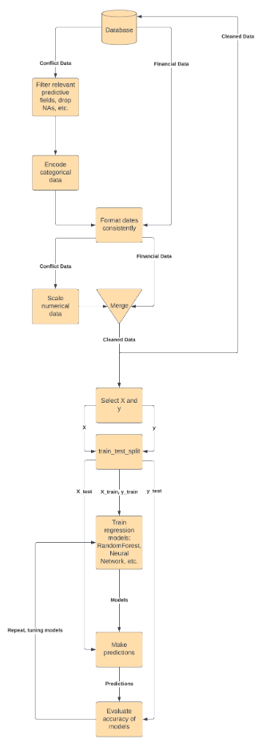
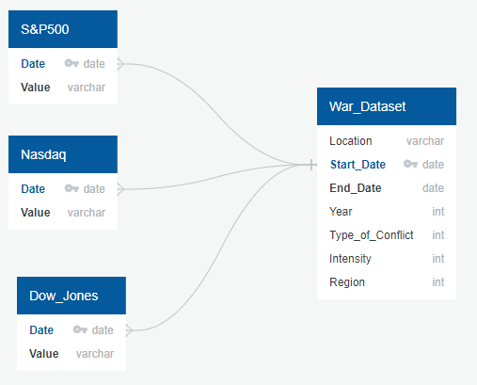
Market Volatility During International Conflicts
Technologies, languages, tools, and algorithms used throughout the project
Applications used:
Excel
Python
PostgreSQL/pgAdmin
AWS-Relational Database Service
Tools:
QuickDBD for ERD Diagram
PowerPoint
Algorithms:
Machine Learning – Random Forest
Group 1
Notes:
Stephen

Slide 7
Market Volatility During International Conflicts
Description of the analysis phase of the project:
Using Jupyter Notebooks the dataset were uploaded to Amazon Web Services. We use Python for cleaning up war dataset file was initiated and joining and cleaning up database for the 3 stock market file for Dowjones, Nasdaq and SP500.
Description of preliminary feature engineering and preliminary feature selection, including the decision-making process:
The feature engineering and preliminary feature selection was performed in the ml_dev.ipynb Jupyter notebook. The first restriction in the data was selecting only the conflict data where we had stock data available.
Next, a function called find_nearest_date() was created to find the nearest stock date given the conflict date, this would be used to merge the stock data to the conflict data in a new dataframe. A binning function, create_bins() was created to allow the easy generalization of binning as there are potentially hundreds of different countries/governments, so this would help to prevent the blowing up of the number of features, given the relatively small number of conflicts.
Binning was performed on all the object dtype columns using the aforementioned create_bins() function. The actual encoding was performed using Pandas.get_dummies() method.
A simple Pandas merge is then used to combine the conflict and stock data, where stock data that is missing any values are dropped, and then NaNs are filled with 0s
Group 1
Notes:
Stephen

Slide 8
Market Volatility During International Conflicts
Explanation of model choice, including limitations and benefits:
The Extra Random Trees Regressor Ensemble model was selected for machine learning.
The primary limitations for this type of model can be extended training time if there is a significant amount of data, and the decision tree model itself could change drastically with the introduction of new data, rather than adjusting the weights on a previously trained model if this had been a deep learning algorithm.
However, for this particular data set there are not too many data points, hence the training time is relatively fast. Conflicts around the world don't arise too frequently as measured by the Uppsala Conflict Data Program (UCDP), as they are defined to occur with 25 or more battle-related deaths in a calendar year.
The major benefits of this model include: being able to see the feature_importances after the training to see which of the features are most relevant in making stock predictions, being able to easily parallelize the training of the model as this is an ensemble method, and being able to easily explain/understand the model after the training.
Group 1
Notes:
Stephen

Slide 9
Market Volatility During International Conflicts
Variables used in the Armed Conflict Dataset
Location – the name of the country/countries whose government has a claim to the conflict.
Side a - the name of the country of side A in the conflict. The government side in intrastate conflicts
Side b – identifying the opposition actor in the conflict, includes military opposition. The primary party in the conflict
Incompatibility – 1 about territory , 2 about government, 3 about govt and territory
Territory Name - the name of territory over which conflict is fought
Intensity Level - The intensity level in the conflict per calendar year. The intensity variable is coded in two categories:
1. Minor: between 25 and 999 battle-related deaths in a given year.
2. War: at least 1,000 battle-related deaths in a given year
Group 1
Notes:
Michele

Slide 10
Market Volatility During International Conflicts
Conflicts Dashboard
Group 1

Slide 11
Market Volatility During International Conflicts
Questions the team hopes to answer with the data
Does the number of the conflict have proportional impact?
Does the geographical location matter to the number of conflict?
3. Does the market bounce back after 90 days from the start of the conflict?
4. Which territory / region or location was greatly affected by the conflicts?
5. Describe the 9/11 market before, during and after the conflict.
Group 1
Notes:
John

Slide 12
Market Volatility During International Conflicts
Questions??
Group 1
Notes:
All

